Slide 1
Web Scraping News Headlines: DATS 6103 Project 2
Graham Hulsey
November 10, 2020

Slide 2
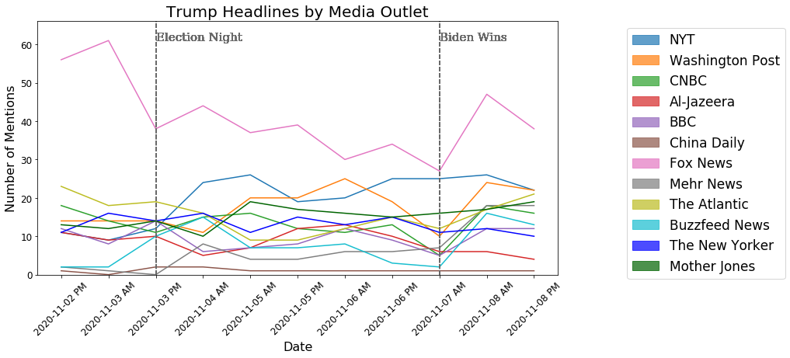
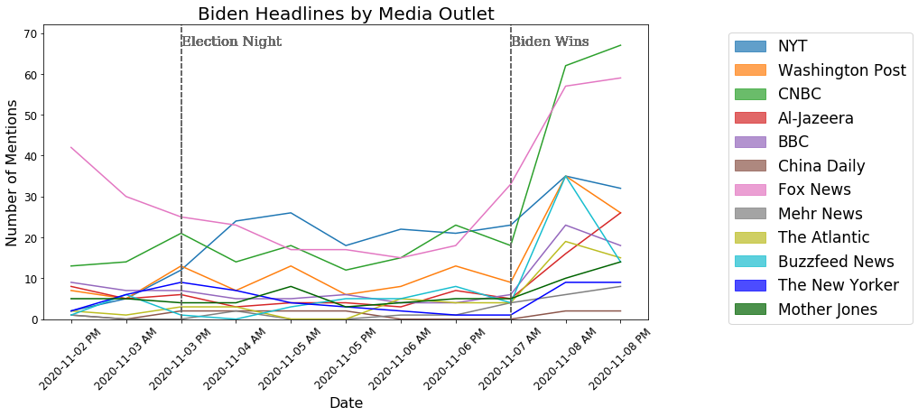
News Coverage of Trump and Biden
Coverage of Trump was largely consistent across time and Fox News covered Trump more than any other outlet, while coverage of Biden was generally lower and spiked after Biden was announced as the winner
Biden-related stories were less important, until he was announced as the winner

Slide 3
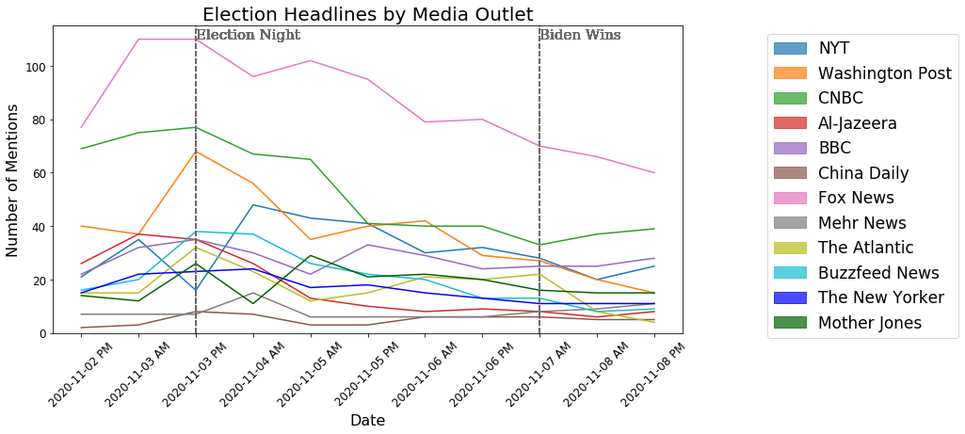
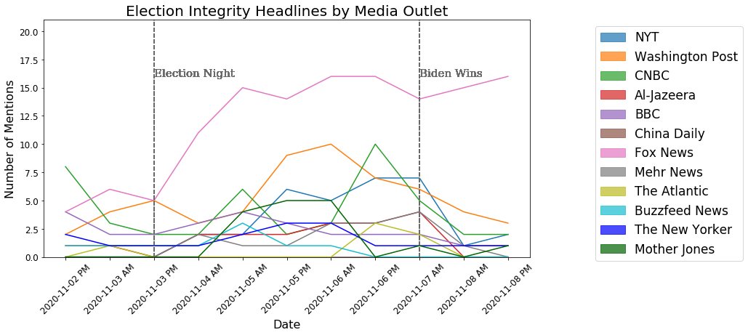
News Coverage of Election Stories
Coverage of the election itself peaked on election night and has steadily declined since
Although not much of a story prior to the election, the integrity and legitimacy of the election became a story after the election, with Fox News covering this issue the most.

Slide 4
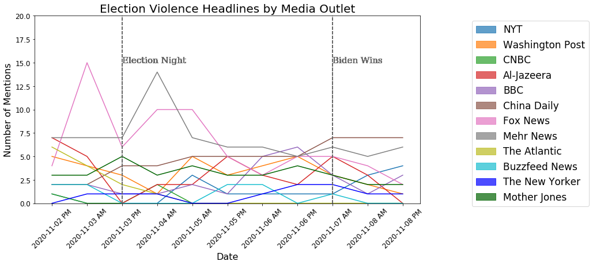
News Coverage of Electoral Violence
One story leading up to the election was the prospect for protests and violence on election day or after. Most news outlets had little or no coverage of this issue, but two covered the issue more frequently: Fox News and Mehr News (an English-language Iranian news outlet).

Slide 5
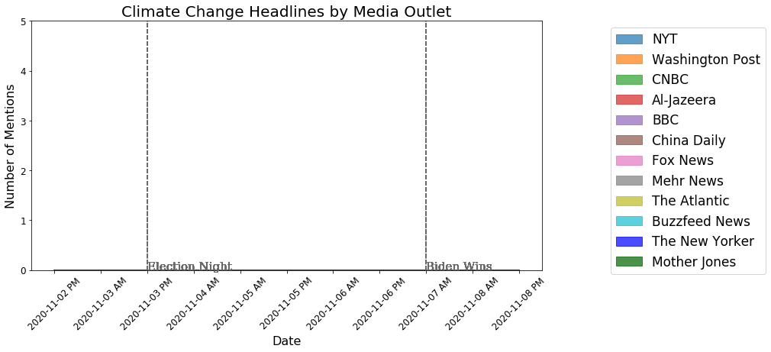
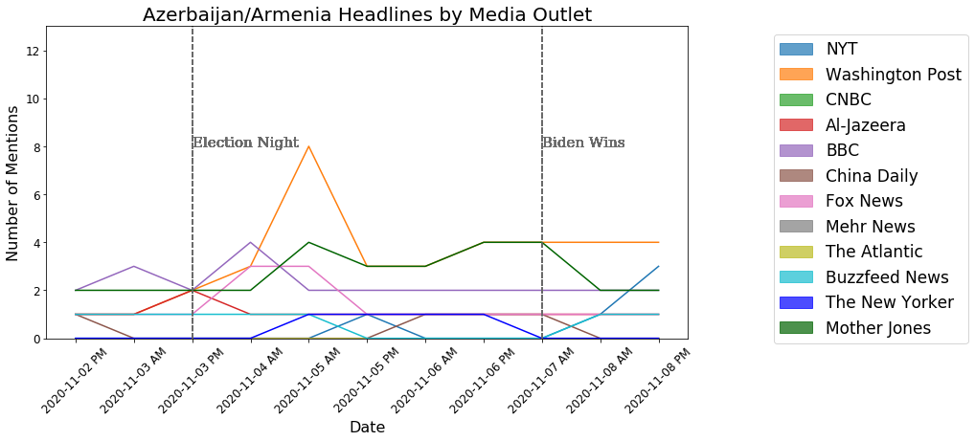
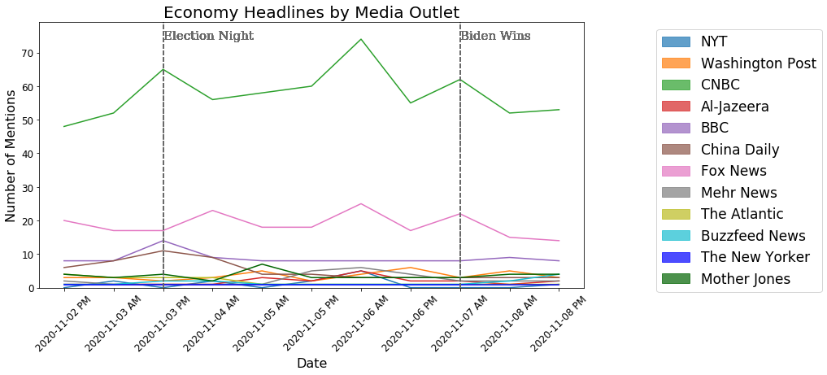
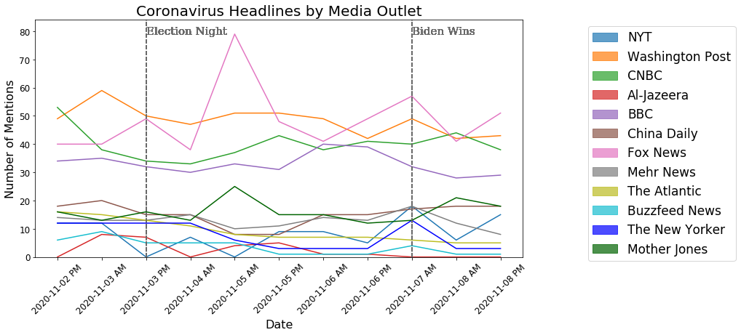
News Coverage of Non-Election Stories
Coverage of non-election stories was mostly constant, and some issues like the economy got more coverage from outlets like CNBC. Climate change did not receive any coverage.

Slide 6
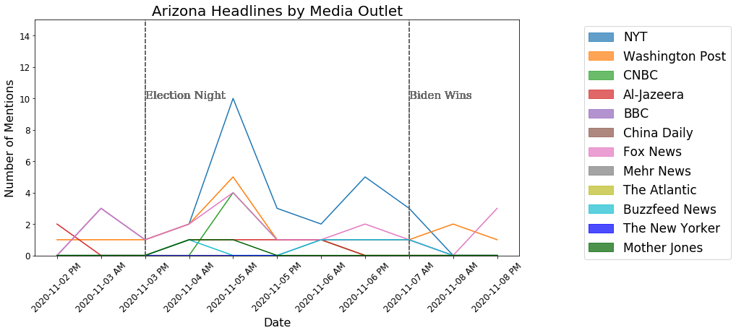
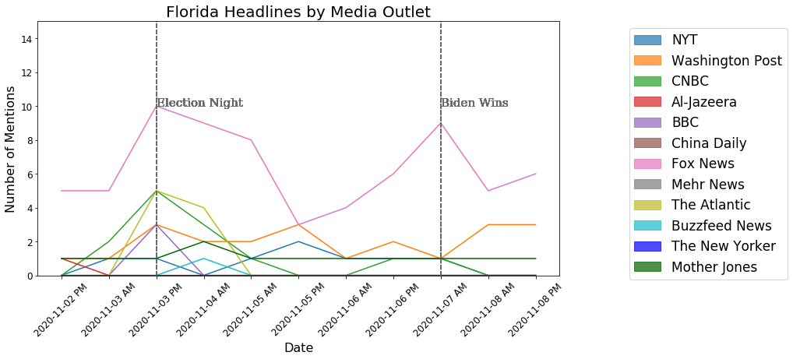
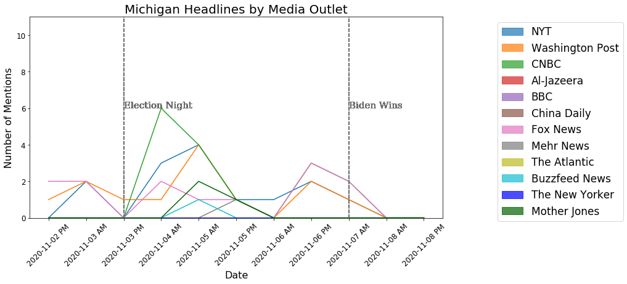
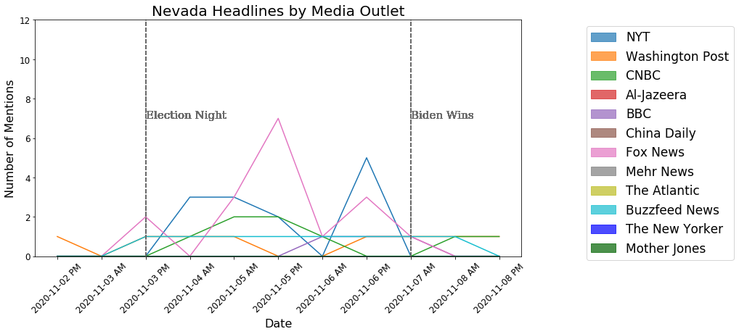
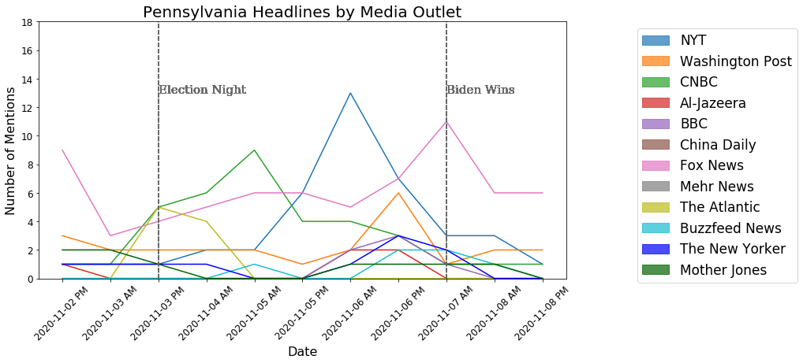
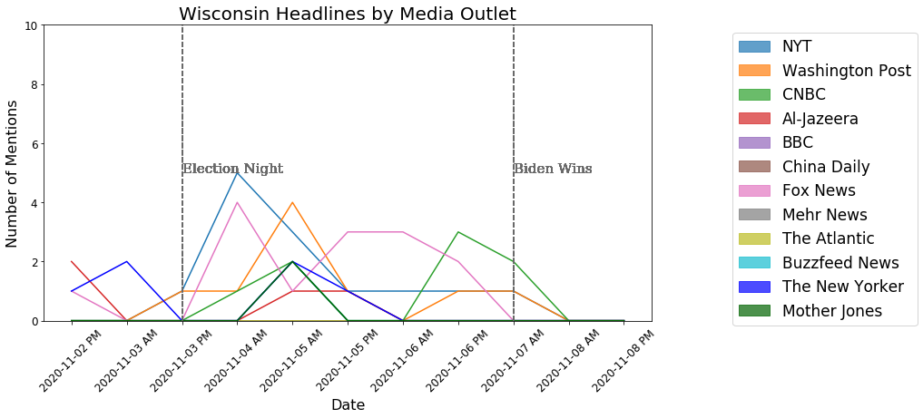
News Coverage of Swing States
Coverage of several swing states tends to peak when that state was called. For example, coverage of Florida peaked on election night when it became clear Trump would win even though Biden was ahead in the polls. Fox News also covered Florida more than any other outlet and any other state.

Slide 7
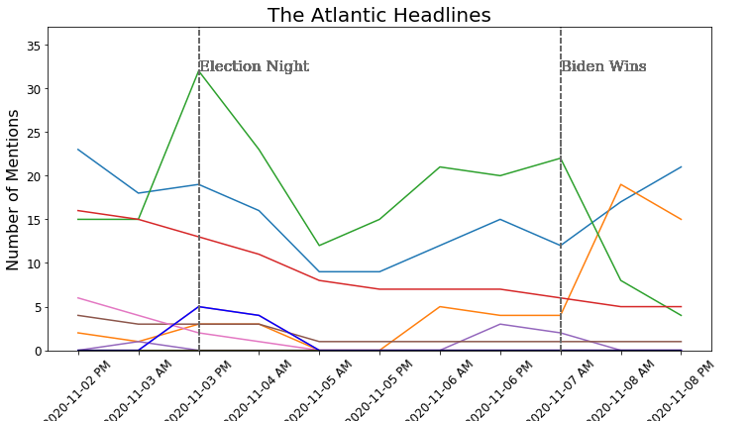
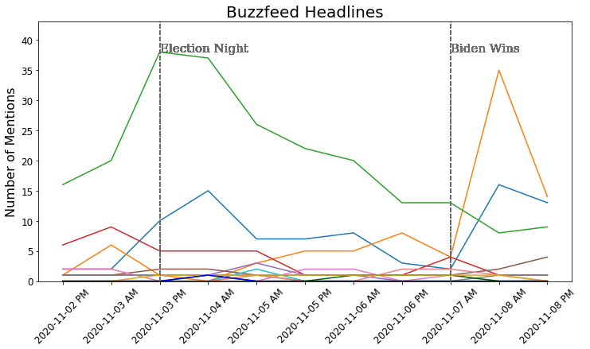
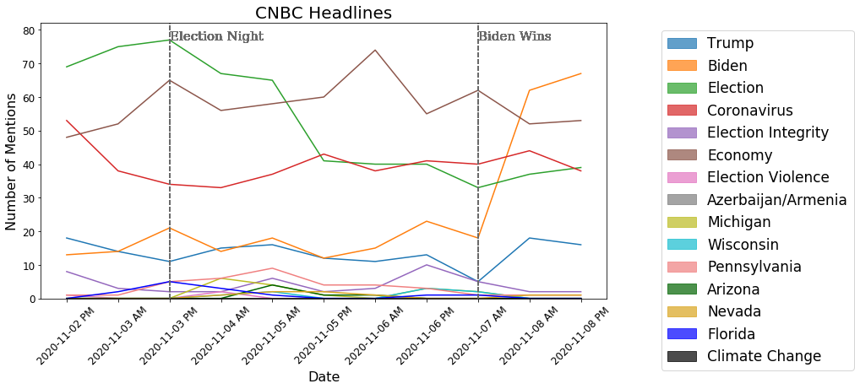
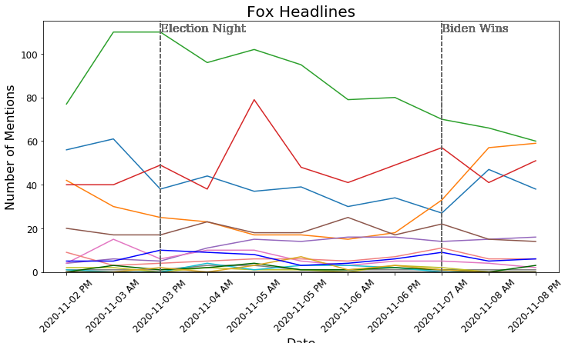
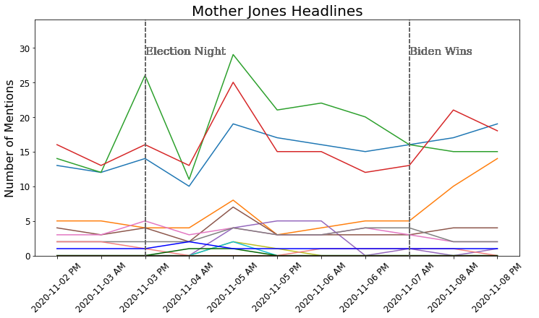
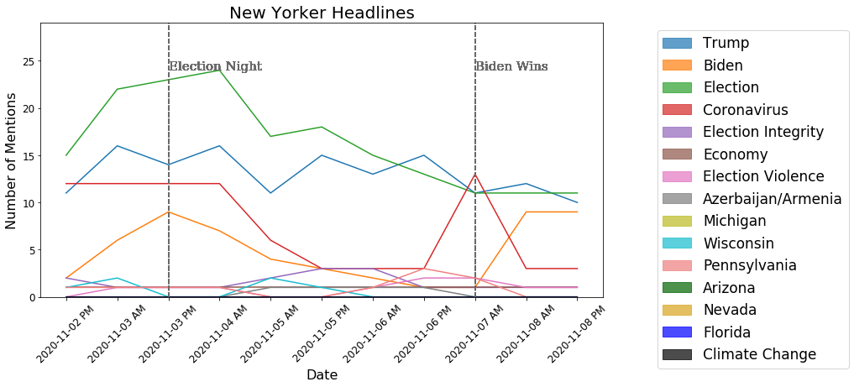
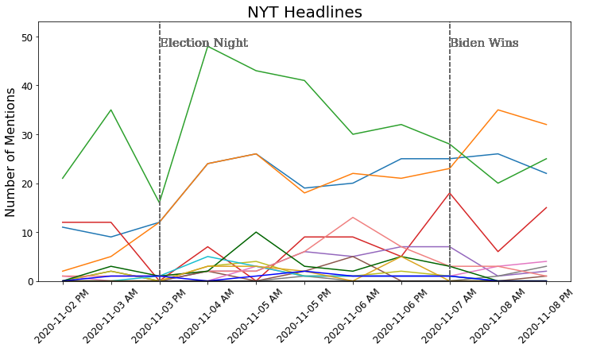
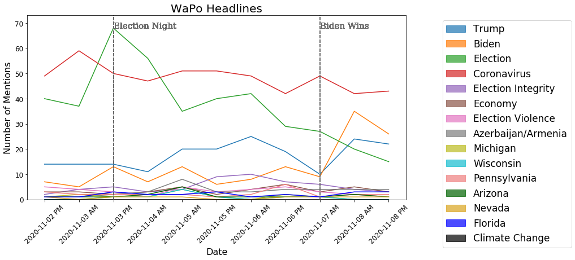
Issue Coverage Among Domestic News Outlets
All US news outlets cover the same 4 stories most frequently: the election, Trump, Biden, and Coronavirus. However, each outlet makes different decisions as to which of those 4 stories to give the most attention to

Slide 8
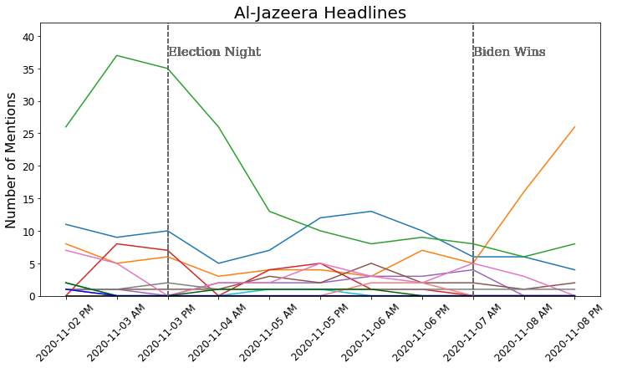
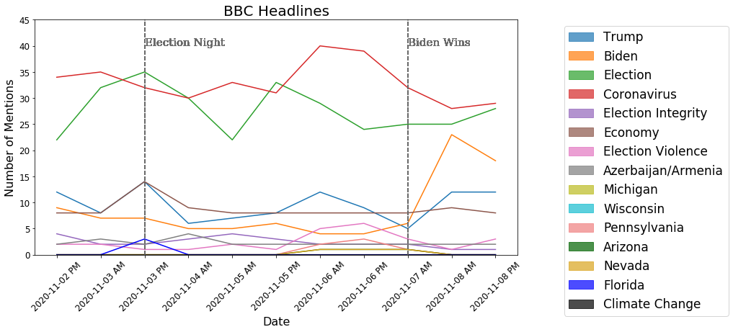
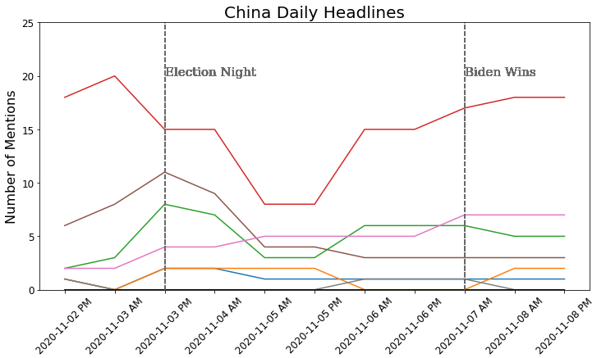
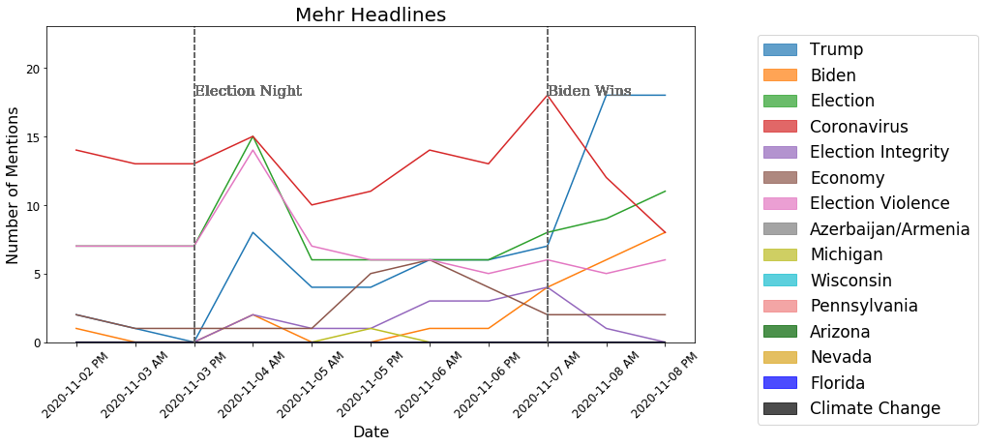
Issue Coverage Among Foreign News Outlets
Among foreign news outlets, there is more variation in which stories are covered and trends over time.
Coronavirus receives coverage and many outlets cover the election at least somewhat, although some chose not to cover the candidates

Slide 9
Conclusion
Studying news headlines can reveal which stories are important to which outlets, and how that changes over time in response to events
There are only minor differences within domestic news outlets, but larger differences between domestic and foreign news outlets.
Major events can change how frequently that issue is covered, but typically does not take space away from other important stories
Data mining and web scraping is an efficient and effective way to conduct this analysis
Project available at Github, github.io, and Zenodo

